Slide 1



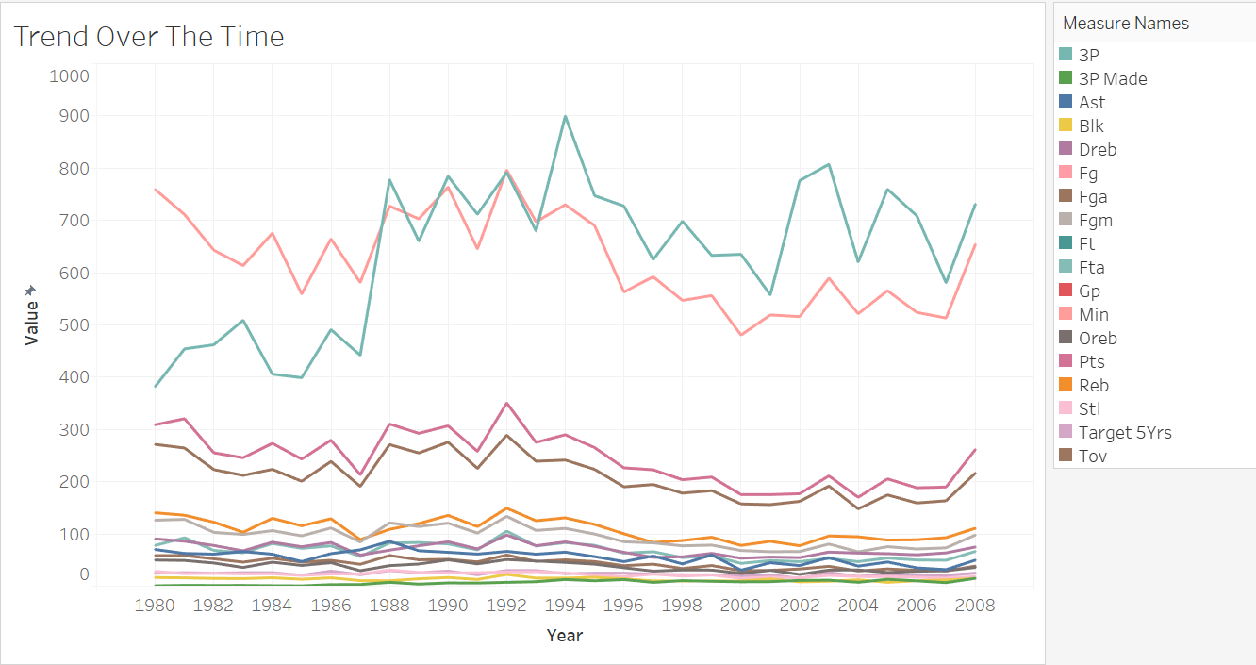
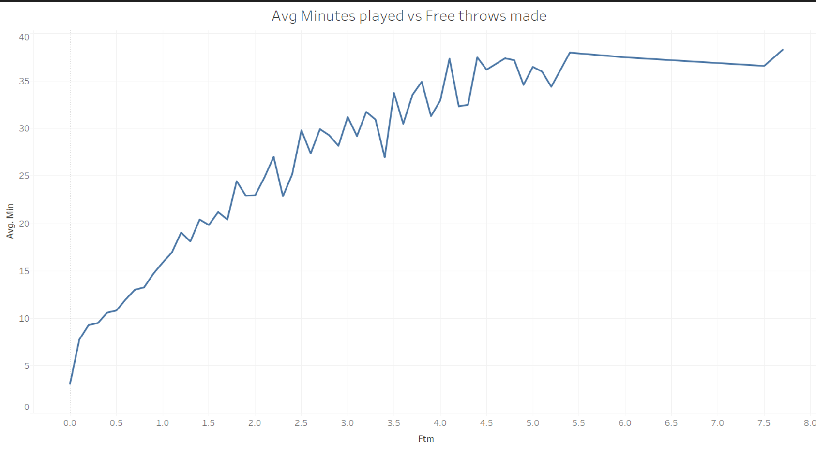
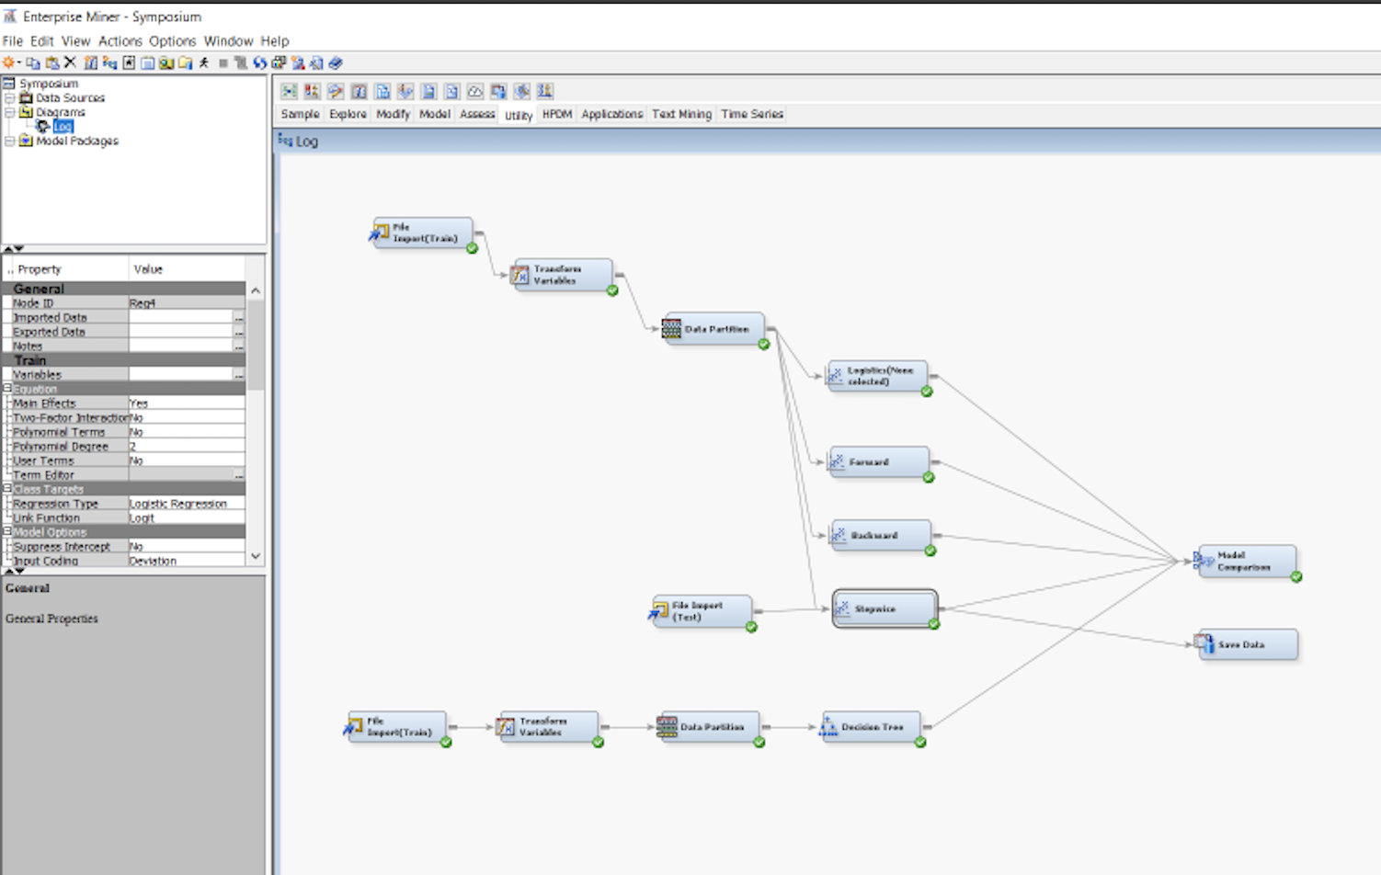
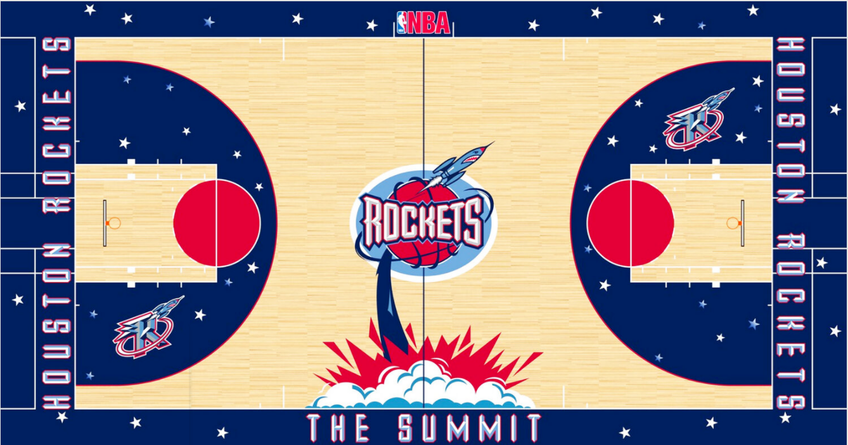
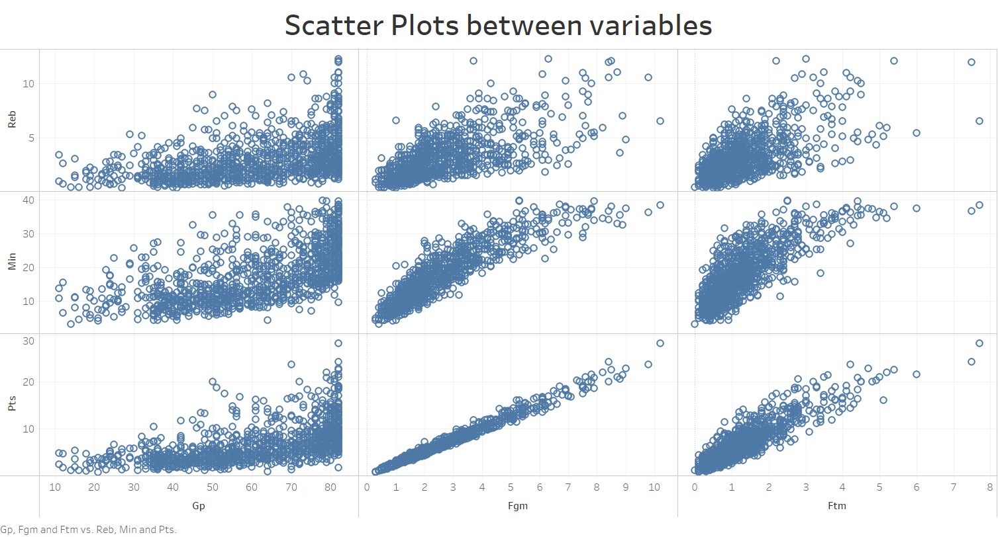
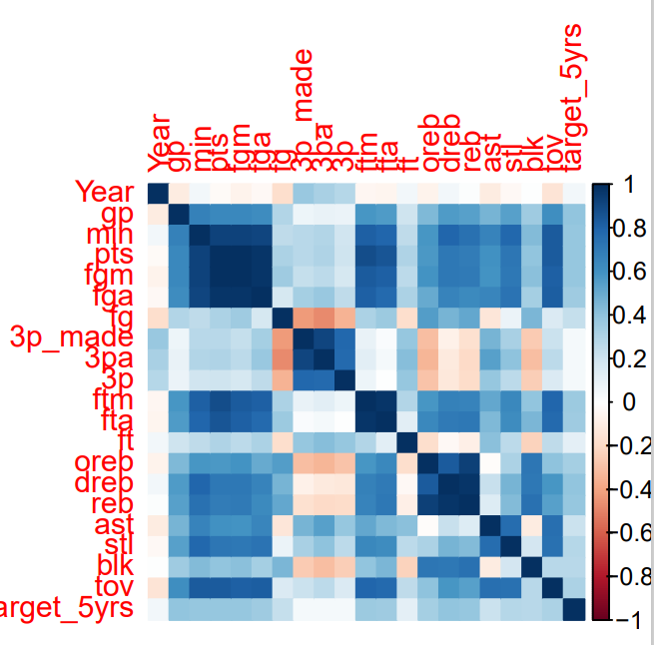
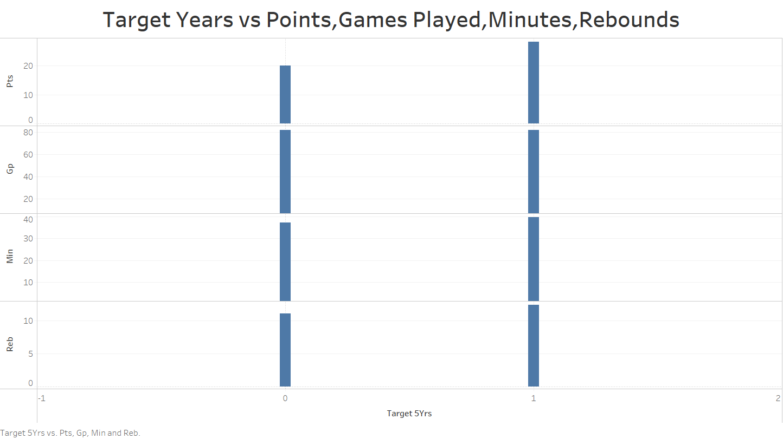
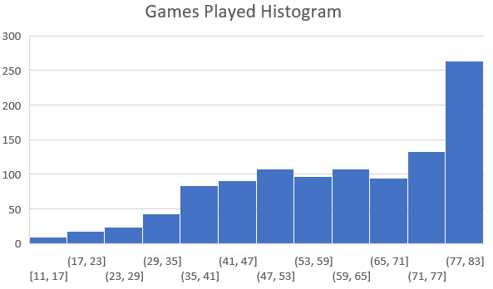
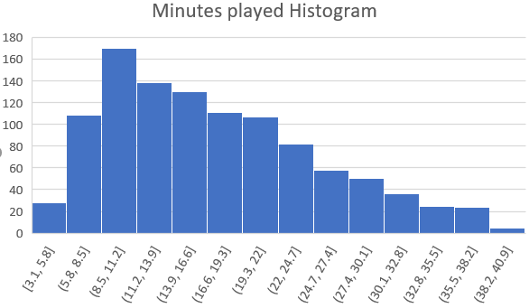

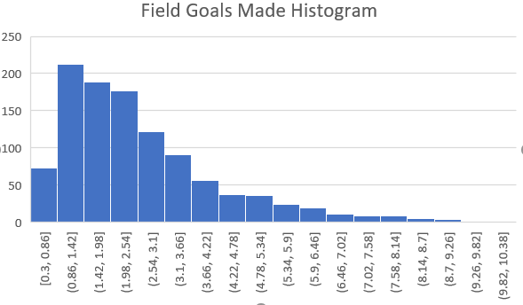
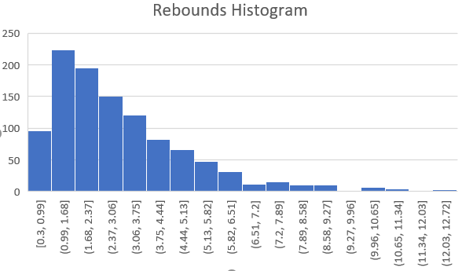
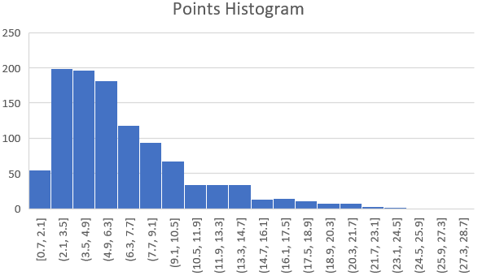
HOW TO FIND GEMS IN THE ROUGH?
AMRUTHALAKSHMI RAJAGOPAL | SAYLEE KHAIRNAR | SHILPA MAHADIK
THE UNIVERSITY OF TEXAS AT ARLINGTON
ABSTRACT
MATERIALS & METHODS
Data Predictions Techniques :
Explains the prediction of response/target variable which is a binary output; Career of a Rookie player in NBA would be defined as 1 ( successful) and 0 (unsuccessful). I have used two supervised learning techniques for our analysis:
Logistic Regression
Classification (Decision trees)
Both the techniques have similar results.
Stepwise Regression has least average squared error and misclassification rate.
•Train: ASE - 0.16597, MCR – 0.25669
•Valid: ASE - 0.17173, MCR – 0.24757
Based on these results the best fitted model for this dataset selected is “Stepwise REGRESSION" model.
CONCLUSION
The national basketball association (NBA) is one of the prominent worldwide basketball leagues. In the NBA, player acquisitions can have a significant impact on a team's success. A traditional way to analyze player is by looking at previous stats with no future predicted which is still an issue that General Managers are struggling with today. This dataset consists of each rookie player’s score point analysis upon which we will be predicting the career longevity for the rookie player and predict if a rookie is successful or not.
Data Visualization:
Time series:
Shows trend of the variables from 1980 to 2008.
Scatter plots and Correlation matrix:
Scatter plots and correlation matrix shows the correlation between different variables. Positive correlation can be seen between games played and minutes played.
Bar chart:
Shows cutoff values for players whose career duration is less than 5 years (Target 5yrs = 0) and more than 5 years (Target 5yrs = 1).
Earlier in traditional methods, the player selection was dependent on the total points scored by each player considering all the parameters as the deciding factor. Whereas, in the implemented prediction technique results of test model i.e., each rookie player's individual points scored in each data parameter were compared with the results of trained model.
This case study assists and guides the sponsors to invest in the correct player by projecting that the Player A would have been the best decision, but another player like Player C has emerged with much more potential 5 -year longevity and can be selected.
This way, we as a digital consulting firm has now targeted the right group of rookie players for our client Houston rockets team.
This consists of the final list of rookie players who are predicted as 1 and tends to have a successful 5 –year career duration longevity.
Thereby, helping the management team to evaluate the team’s budget for trading/extending the contract of the below listed rookie players.
Final team:
Name | Games Played | Field Goals(%) | Free Throws(%) | Rebounds | Assists | Target (5years)
Loren Meyer | 56 | 41 | 80 | 1.6 | 1.9 | 1
Theo Ratliff | 47 | 44.7 | 72.1 | 3.6 | 0.7 | 1
DeMarcus Cousins | 32 | 41.4 | 65.2 | 5.1 | 0.9 | 1
Anthony Goldwire | 38 | 45.5 | 65.2 | 5.1 | 0.9 | 1
Jordan Williams | 52 | 45.2 | 66.7 | 2.1 | 1.4 | 1
Jimmy King | 60 | 60.8 | 37.1 | 7.6 | 0.5 | 1
Shabazz Napier | 40 | 39.1 | 91.7 | 0.8 | 0.5 | 1
Lawrence Moten | 29 | 31 | 85 | 2.4 | 0.7 | 1
Greg Ostertag | 64 | 51.6 | 75.1 | 8.2 | 1 | 1
Chris Carr | 47 | 58.2 | 64.3 | 3.1 | 0.2 | 1
Travis Best | 69 | 46.4 | 82.1 | 2.5 | 0.5 | 1
Jason Caffey | 61 | 37.2 | 54.6 | 1.8 | 2.1 | 1
RESULTS
OBJECTIVE
The rows highlighted in green color show the comparison of the rookie player’s efficiency despite number of games played and other aspects, thereby having a successful 5 -year career duration longevity. The default threshold value is 0.5.
The rows highlighted in yellow color are the ones which did not make it to the final selection.
Train:
Test:
This project attempts to determine the following questions:
If a player will survive in the league for at least for 5 years in NBA.
2. Which factors are significant in determining the performance of the rookie player in their first year?
3. Who will be benefitted by this analysis?
- A club franchise that invests a large amount of revenue into the players.
- Players, so that they can improve their performance in specific area.
Name | Games Played | Field Goals(%) | Free Throws(%) | Rebounds | Assists | Target (5years)
Bill Laimbeer | 74 | 47.8 | 79.3 | 2.1 | 1.5 | 1
Dave Batton | 81 | 46.8 | 73.3 | 2.9 | 3.7 | 1
Glen Rice | 40 | 32.7 | 55.6 | 0.9 | 1.4 | 0
REFERENCES
Histogram: Shows the overall data distribution. Data of the variables Minutes played, Field goals made, Rebounds, Points are skewed to the right, whereas Games played is left skewed.
• SAS Enterprise Miner 15.2
• Tableau Desktop 2021.2.1
• R Studio
• Microsoft Excel
• Microsoft Word
• https://www.kaggle.com
Name | Games Played | Field Goals(%) | Free Throws(%) | Rebounds | Assists | Target (5years)
DeMarcus Cousins | 32 | 41.4 | 65.2 | 5.1 | 0.9 | 1
Jeff Withey | 38 | 45.5 | 59.1 | 0.9 | 1.2 | 0
Jordan Williams | 52 | 45.2 | 66.7 | 2.1 | 1.4 | 1
ACKNOWLEDGEMENTS
We would like to express our sincere thanks and gratitude to our professor Dr. Jayarajan Samuel for the support and guidance in completing this project.
We would also like to thank Dr. Santoso Budiman and Dr. Jennifer Zhang for giving us this opportunity to showcase our work.
Submitted by: Mahadik, Shilpa | sxm4896@mavs.uta.edu
Khairnar, Saylee Mahendra | smk0462@mavs.uta.edu
Rajagopal, Amruthalakshmi | axr9164@mavs.uta.ed

